Slide 1
Powerpoint and other tech stuff

Slide 2
File backup / transfer
Email to yourself
Cloud storage
Time Machine (Mac), File History (Windows)
USB flash drive
External hard drive (HDD)
SanDisk | Price ($) / GB
16 GB | 0.44
32 GB | 0.38
64 GB | 0.25
Seagate | Price ($) / GB
1 TB (1,000 GB) | 0.06
2 TB (2,000 GB) | 0.03

Slide 3
File creation / submission
You must use Powerpoint (.pptx) or Adobe Acrobat (.pdf) to make your presentation (NO Keynote, Prezi, etc.)
Upload your .pptx or .pdf file to the CourseWorks web page of EESC BC 3800/01 (under ‘shared files/mini conference’) before noon of the day of your presentation
Use LastnameF.pptx as the filename and add your ‘Lastname, Firstname’ under ‘title’ when you post the file
e.g., filename: GoodridgeB.pptx
Please DO NOT bring your presentation on a USB drive to class or download it from your mail account to the presentation computer in the front

Slide 4
Mac-PC (in)compatibility
Projection equipment at Barnard is PC-based
Common problems: fonts not recognized and images not transferred correctly
Solutions: use common fonts (e.g., Arial, Calibri) and common image formats (.png, .jpg, .gif), NOT .tif
If using Mac, ensure that your Powerpoint looks ok on PC before giving your presentation
Converting .pptx to .pdf (Adobe Acrobat) is another option (but can’t use animation with this option)

Slide 5
Powerpoints: slide design
Use standard 4:3 slide format (the projector’s constraint)
Use simple slide background (monotone, no patterns)
Use same slide background throughout presentation
Dark text on light background is best for presentations in a smaller venue to a smaller audience with more ambient light (e.g., classroom)

Slide 6
Powerpoints: slide design
Use standard 4:3 slide format (the projector’s constraint)
Use simple slide background (monotone, no patterns)
Use same slide background throughout presentation
Dark text (black) on light background (white) best for presentations with smaller venue/audience with more ambient light (e.g., classroom)
Light text (white or light gray) on dark background (dark blue or black) best for presentations with larger venue/audience with less ambient light (e.g., conference)

Slide 7
Powerpoints: fonts
In general, fonts should not be smaller than 18 point or larger than 44 point
Use only one font style throughout presentation
Use sans serif, not serif fonts
Sans serif (e.g., Calibri):
The quick fox jumped over the lazy dog
Serif (e.g., Times New Roman):
The quick fox jumped over the lazy dog

Slide 8
Powerpoints: text
Use text sparingly, with sentences typically no longer than two lines
Bullet points help organize information into discrete talking points
For slides with multiple points of discussion, reveal each point one at a time (Animations in Powerpoint)
Keeps audience focused on each point and your speaking
Prevents audience from reading ahead and becoming distracted
Distraction happens, focus instead on the audience members rapt by your talk
Use
animations
judiciously
: simple is best (e.g., ‘appear’, ‘fade’)

Slide 9
Powerpoints: high quality images
Journal websites (e.g., Science paper)
PDFs of scientific papers
“Acrobat Reader” → “Preferences” → “General” → “Use fixed resolution for Snapshot tool images”
Set to 150 pixels/inch (max capability)
Under “Edit” → “Take a Snapshot”
Drag box around desired image
Release mouse button and area is copied, allowing for paste into .pptx
Scans from printed materials
Drawing tools in Powerpoint

Slide 10
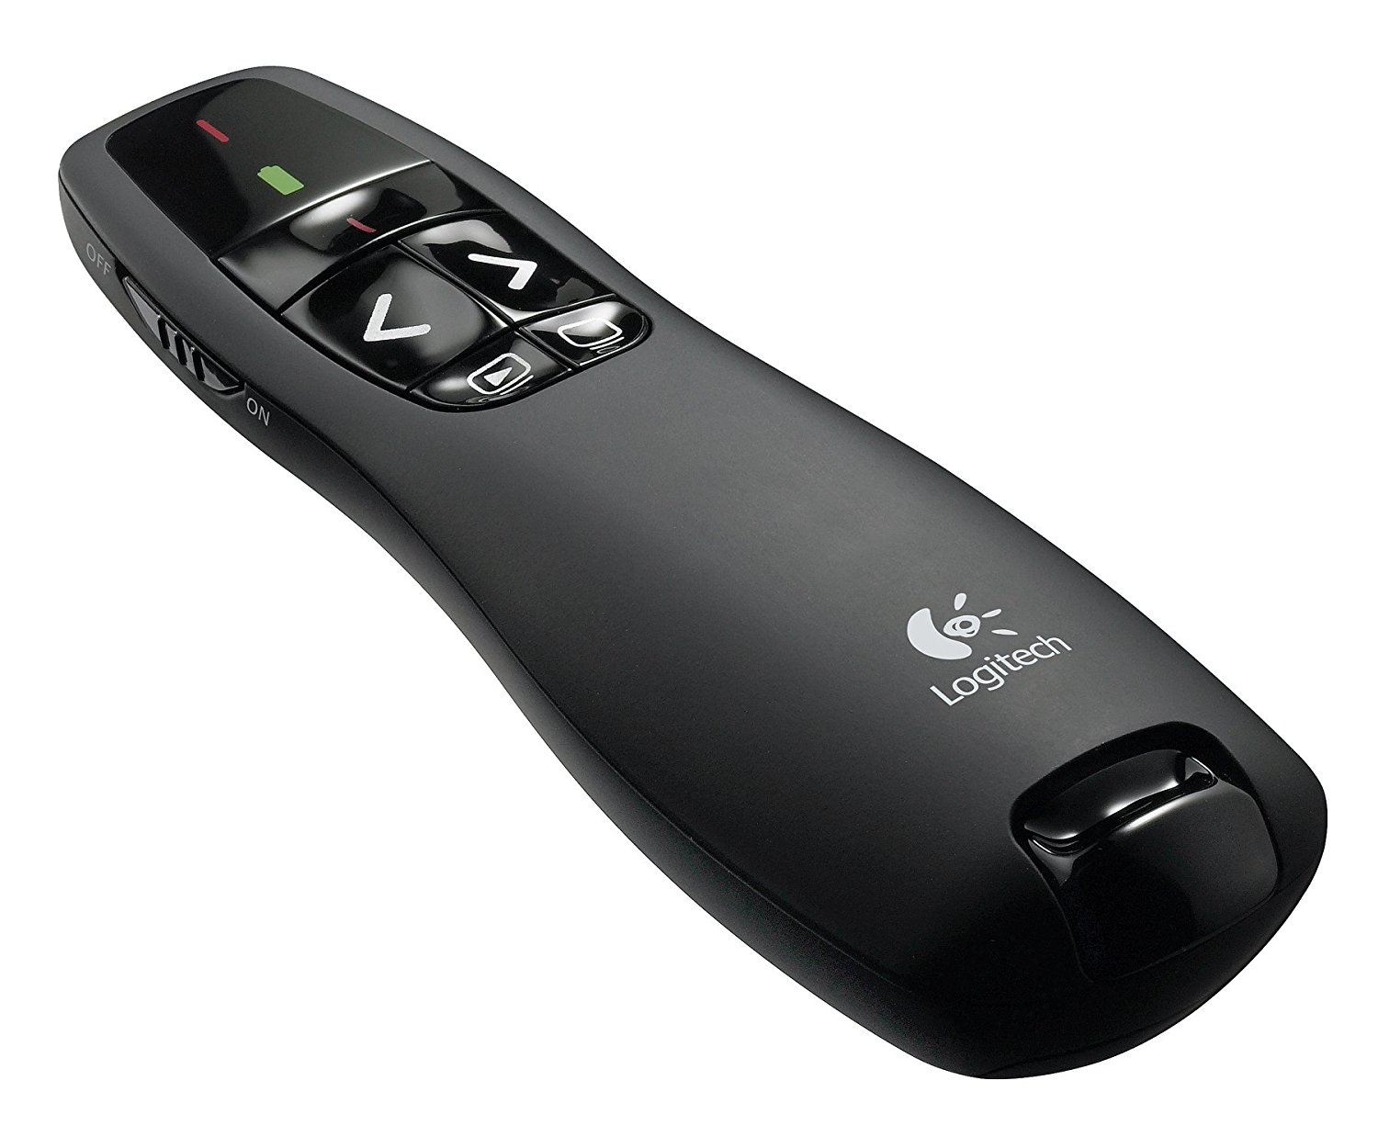
Powerpoints: remote control
You will use a remote control for changing slides
Can also be used as a laser pointer
Remote will vibrate at 5 minutes and 2 minutes remaining

