Slide 1
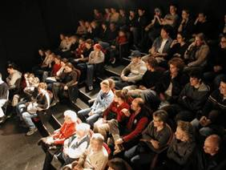
Giving Research Presentations
Stephanie Pfirman, Martin Stute, Hugh Ducklow and the
Environmental Science Senior Seminar Faculty and Students
Barnard College & Columbia University
3/7/2018
Notes:
Points to make in addition:
- No reference slide!

Slide 2
Outline
Introduction - Why give talks
Structuring your story
Preparing your data/information
Preparing and giving the presentation
Concluding your presentation
Example
What can go wrong?
Handling questions and answers
Notes:
Don’t just state the obvious: Introduction, methods, results, discussion, conclusions

Slide 3
Why Give Presentations
“If you don’t kick things around with people,
you are out of it.
Nobody, I always say, can be anybody
without somebody around.”
Physicist John Wheeler
“Your thinking improves, the more you talk about it.
You need to be seen and heard, to be known and read.”
Psychologist Mihaly Csikszentmihalyi
Notes:
You have really only understood something after you have successfully explained it to somebody who knows nothing about it

Slide 4
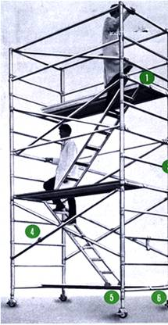
How to Give an Effective Presentation: Structure
Basic rule
  Say what you are going to say
    1-3 main points in the introduction
  Say it
    Give the talk
  Then say what you said
    Summarize main points in the conclusion
People need a framework to receive information – telling them where you are going primes them for the information you present to be meaningful
http://www.safetyoffice.uwaterloo.ca/hspm/tools/images/scaffold_stair.png

Slide 5

Tell a Story
http://battellemedia.com/images/book_open.jpg
Why and to whom are you giving this presentation?
  What do you want the audience to learn?
  Tailor your presentation to the situation – does not have to be complete
Prepare your material so that it tells a story logically –
Do not use this outline for your proposal presentation
  Title, authors, acknowledgements
  Introduction/overview/reason for research
  Thesis statement/project goals
  Methods/approach
  Preliminary results/information/analysis
  Broader implications/next steps
http://www.cgd.ucar.edu/cms/agu/scientific_talk.html

Slide 6
Presenting Your Methods and Results
Methods, Instrumentation
  For most talks, only present the minimum
  People can ask more if they are interested.
  Use photos/images
Results Data Presentation
  Tables are useful for a small amount of data
  Include units
  Indicate data source if they are not your own
  But tables are often used badly …
  Use figures instead of tables whenever possible

Slide 7
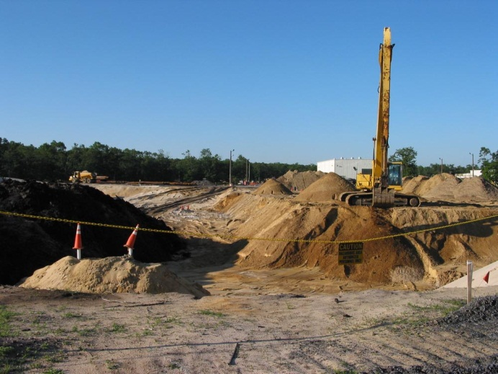
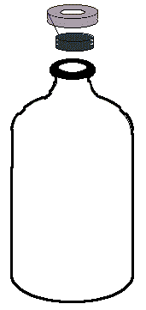
Methods
PCR
Sequencing
Vineland Chemical Co. Superfund Site
ATGGCTCAATGCTT
Microcosm
Extraction
Groundwater with Acetate + Arsenate
Elemental analysis and arsenic speciation
Trimming, Alignment and Tree
Sediment
Notes:
The polymerase chain reaction (PCR) is a technology in molecular biology used to amplify a single copy or a few copies of a piece of DNA across several orders of magnitude, generating thousands to millions of copies of a particular DNA sequence

Slide 8
Esopus Creek Hydrology
Discharge of the Esopus Creek (Coldbrook, NY) and precipitation at Slide Mountain, NY (source: USGS & NCDC)

Slide 9
Esopus Creek Hydrology
Discharge of the Esopus Creek (Coldbrook, NY) and
precipitation at Slide Mountain, NY (source: USGS/NCDC)
Notes:
Explain axes on the figure

Slide 10
Figures
‘1 figure ≈ 1000 words’
Figures should be readable, understandable, uncluttered
Keep figures simple, use color logically for clarification
  Blue = cold, red = warm, dark = little, bright = a lot
  Invisible color
  Meaning attached to colors (~10% of population is color blind)
Explain axes and variables
Include reference for data and images on figure
http://www.cs.aau.dk/~luca/SLIDES/howtotalk-ru.pdf

Slide 11
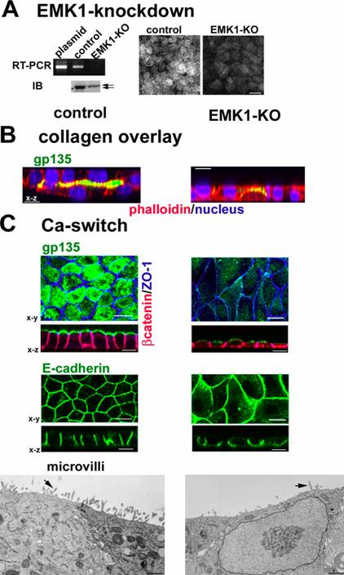
Emk1 knockdown inhibits lumen formation in MDCK cells:
RT-PCR: EMK1 is effectively knocked down in MDCK cells 24 hours after transfection with P-SUPER (control) or P-SUPER-siEMK1 plasmid; knockdown confirmed on the right with antibodies to EMK1.
Collagen overlay assay: cells cultured 24 h on collagen I before being overlaid with additional collagen on the apical surface, analyzed 24 h later. Note the lack of lumen in EMK1-KO cultures.
Ca switch: control or EMK1-KO cells were plated in low Ca medium 24 h upon transfection with pSUPER or pSUPER-KO. After 12 h, cultures were switched to normal medium for 24 h. Transmission EM of cells sectioned perpendicular to the substratum shows lack of microvilli in EMK1-KO cells.
WAY TOO BUSY!!!!
http://www.fw.msu.edu/orgs/gso/documents/GSOWorkshopDocsSp2006/PresentationTipsinPowerPoint.ppt#428,1,Tips for Preparing and Giving an Effective Scientific Presentation using Powerpoint

Slide 12

Cartoons
Domestic
use
Irrigation
As
As
As
As
Create a summary cartoon, flow chart or concept map with major findings, or an illustration of the processes or problem
  Consider showing it at the beginning and the end
You can use web sources for figures
  Include reference!

Slide 13
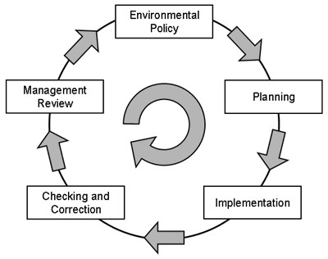
Environmental Policy
https://www.niehs.nih.gov/about/stewardship/faq/index.cfm

Slide 14
Animations
first rain
ocean water
second rain
evaporation
third rain
evaporation of surface water
kinetic frac.
first vapor, equilibrium

Slide 15
Preparing the Presentation
Average not more than 1 slide per minute
Powerpoint, PDF are standard
  Avoid others, convert Keynote to PDF files
  Prezi causes nausea!
No random sounds, logical animations OK – not these!
Use 3-7 bullets per page
  Avoid writing out, and especially reading, long and complete sentences on slides because it is really boring to the audience
Consistent slide appearance: font, colors, animations
Speelcheck
Notes:
Technical side of things

Slide 16
What Font to Use
Serif
Sans Serif
annoying
Type size should be 18 points or larger:
18 point
20 point
24 point
28 point
36 point
AVOID USING ALL CAPITAL LETTERS BECAUSE IT’S MUCH HARDER TO READ
* References can be in 12-14 point font
http://www.fw.msu.edu/orgs/gso/documents/GSOWorkshopDocsSp2006/PresentationTipsinPowerPoint.ppt#307,6,Powerpoint basics: 1. What font to use

Slide 17
Color
Dark letters against a light background work
Best for smaller rooms, especially when
lights are on
http://www.fw.msu.edu/orgs/gso/documents/GSOWorkshopDocsSp2006/PresentationTipsinPowerPoint.ppt#302,5,Powerpoint basics: 1. What font to use

Slide 18
Color
Light letters against a dark background
also work
Many experts feel that a dark blue or black background works best for talks in a large room
http://www.fw.msu.edu/orgs/gso/documents/GSOWorkshopDocsSp2006/PresentationTipsinPowerPoint.ppt#302,5,Powerpoint basics: 1. What font to use

Slide 19
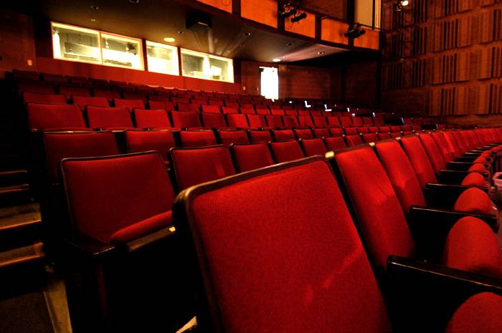
Preparing Yourself
Immerse yourself in subject
  Web of Science/Google it: use the latest news
Familiar with the projection equipment, remote control
For presentations other than Senior Seminar
  Bring memory stick AND a laptop WITH power supply AND extension cord
  Printed copies of your slides (‘handouts’), or on your phone
    Annotate and use as notes, review as you’re waiting
    Helps if everything crashes, the bulb blows
www.terryfoxtheatre.com/theatre_specification...

Slide 20

Rehearsing
www.thomas.edu/facilities/auditorium/index.htm
Practice – actually stand up and say the words out loud
  Discover what you don’t understand
  Develop a natural flow and come up with better phrasings and ways to describe things – no uptalk!
  Stay within the time limit
  Try speaking too loud to get a feeling where the upper limit is
Don’t over rehearse or memorize the talk
http://www.fw.msu.edu/orgs/gso/documents/GSOWorkshopDocsSp2006/TipsforGivingaScientificPresentation.pdf

Slide 21
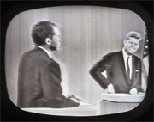
What to Wear …
Dress up – maybe wear a jacket?
  More formal attire makes you appear more authoritative and you show you care enough to try to look nice
  “Snappy Casual”
  Dark clothes are more powerful than light clothes
  Shirts or blouses with collars are better than collarless ones
  Clothes with pressed creases (!) are signs of power
“Ask Dr. Marty” AnimalLabNews (Jan-Feb 2007)
Notes:
Depends on customs in the field, Earth scientists are viewed with suspicion if they wear a tie

Slide 22

Starting
Starting out is the hardest part of the talk
  Memorize the first few lines so that you are confident looking directly at the audience …
  “Hello, I’m Stephanie Pfirman. The title of my talk is, ‘How to Give a Research Presentation.’ By the end of this presentation you should feel confident giving a talk ….’”
http://soroptimistofgreaterdavis.org/documents/images/photos/speaker.gif
http://www.fw.msu.edu/orgs/gso/documents/GSOWorkshopDocsSp2006/TipsforGivingaScientificPresentation.pdf

Slide 23
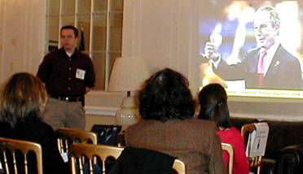
Eye Contact
Experienced speakers
  Speak freely and look directly at audience
  Remember to roam around the room – don’t lock onto 1 person!
Inexperienced speakers
  Put outline and key points of your presentation on your slides
  This procedure helps you be more comfortable
    You don’t have to remember what to say
    Eyes are on the slide not on you
    Key points are there in case you forget to say something and also for people who weren’t listening or who are visual learners
http://www.metclubnyc.org/slide%20show.jpg

Slide 24
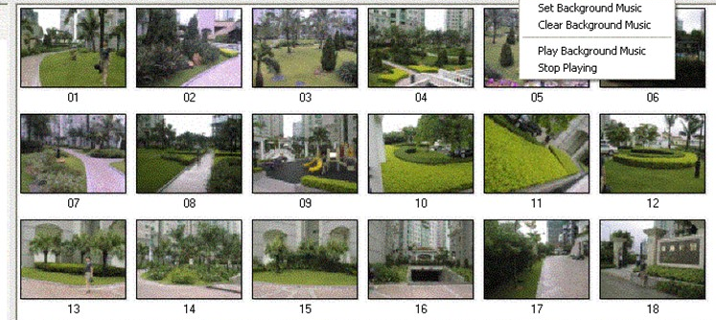
Presenting the Presentation
Stand where the figures can be seen
Track your talk using the monitor
  Not the screen – you lose eye contact with the audience
Not all monitors show notes, next slides
Pace yourself
  In case there is no timer, figure out which slide is your half-way mark and use that to check your time
http://www.dvd-photo-slideshow.com/screenshot/01.gif

Slide 25
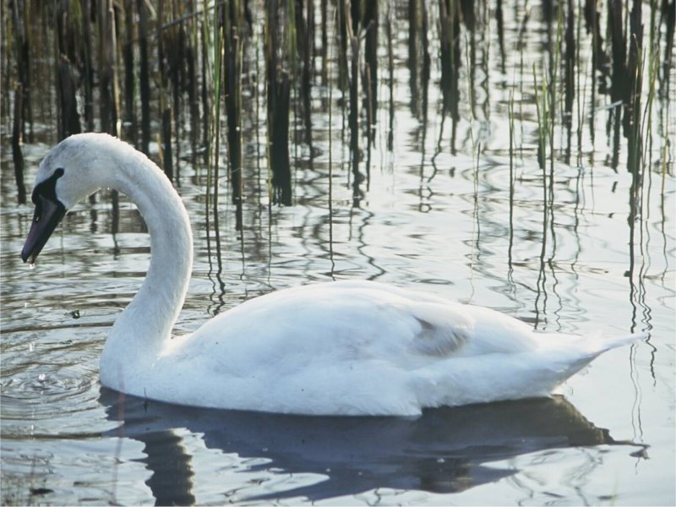
Some “Don’ts”
Don’t apologize or make comments about yourself
  “I hope you’re not bored”
  “I was working on this ‘til 3 am”
Don’t overuse the pointer
Don’t try to be cute and don’t force being funny
  Stay formal
Don’t forget acknowledgements, always give proper credit
  Tip: Everyone in the audience has come to listen to your lecture with the secret hope of hearing their work mentioned
Don’t raise your voice at the end of sentences - uptalk
  Don’t try to build suspense and then unveil a surprise ending

Slide 26
Concluding
Have only a few concluding statements
Come back to the big picture and summarize the significance of your work
  Extend logically beyond your limited study – but don’t overreach
Open up new perspectives
  Describe future work, raise questions, potential implications
Leave your conclusion slide up during questions
Don’t end with a slide of references!
http://www.cs.aau.dk/~luca/SLIDES/howtotalk-ru.pdf

Slide 27
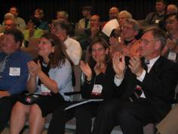
Finishing
Think carefully about your final words and how to finish your presentation strongly
  Don’t just drift off … “I guess that’s all I have to say …”
  You may want to actually memorize your ending lines, just as you do your starting points
Ending your talk
  Say “Thank You” … pause for applause … then
  Say “Any questions?”
http://international.internet2.edu/images/CLARA-I2-MoU/i2-clara-applause.JPG

Slide 28
Example
By Hugh Ducklow

Slide 29
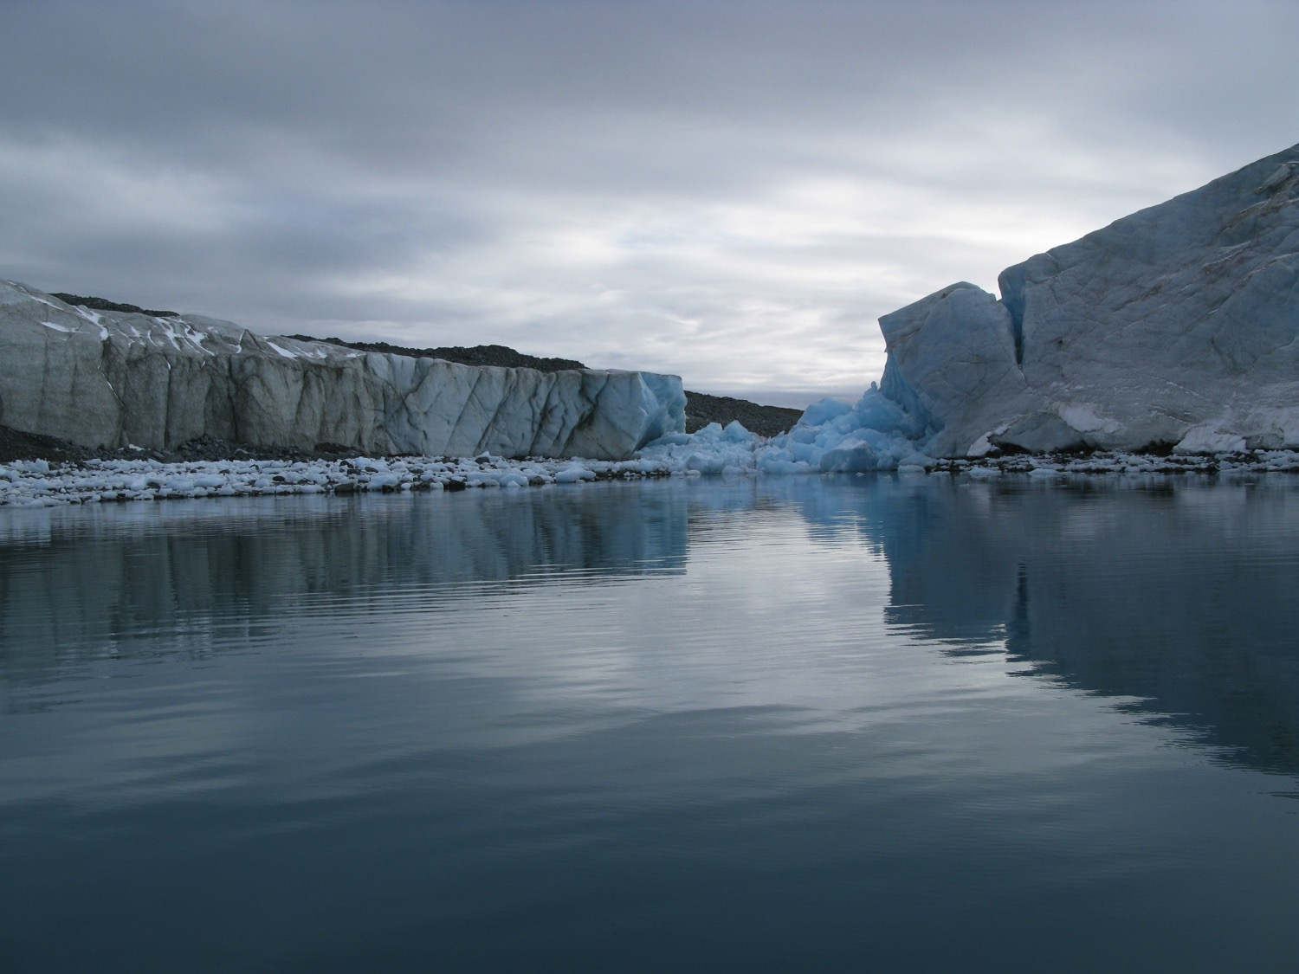

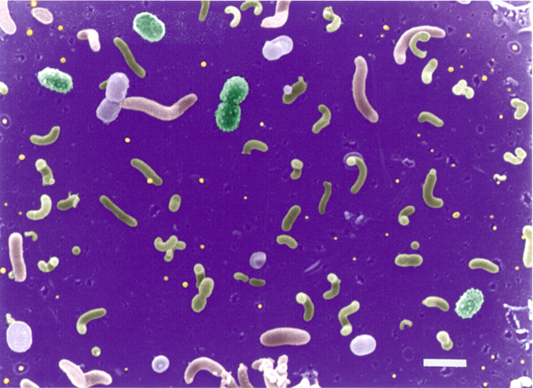
Bacterioplankton community composition
in Antarctic Seas
Thesis Proposal
Hugh Ducklow
Columbia University
Mentor: Catherine Luria, Brown Univ.
Advisor: Martin Stute, Barnard College

Slide 30
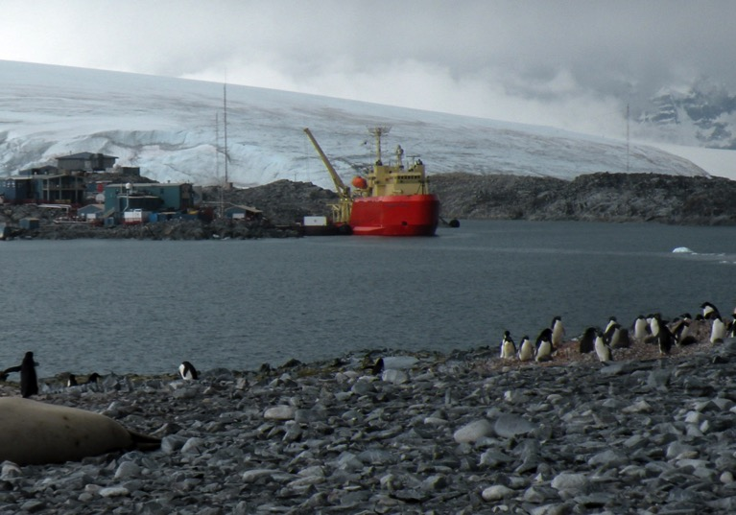
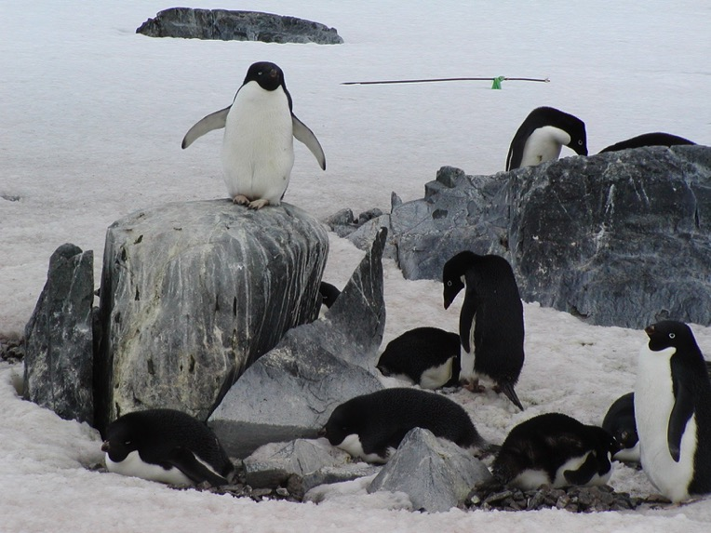
Main Points:
The West Antarctic Peninsula climate is warming very rapidly
Ecosystems are responding to the climate change
Responses seen at every level of food chain: phytoplankton, krill, penguins & seals
But we know very little about bacteria.
“omics” tools enable us to determine taxonomic & functional composition and changes in plankton communities

Slide 31
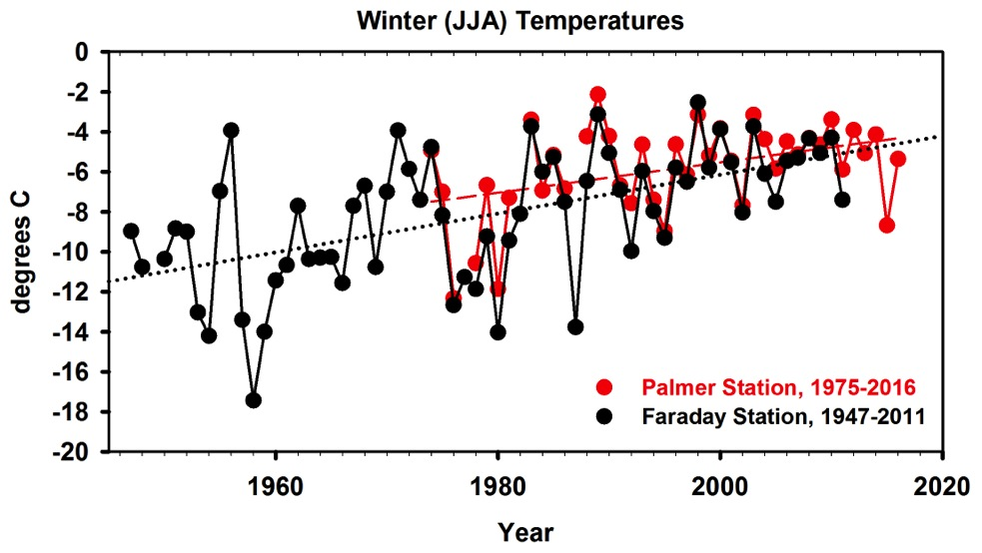
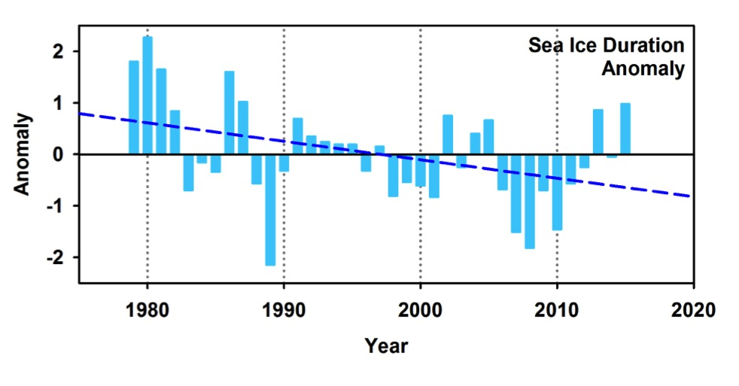
Physical Climate:
Winter surface air temperature:
Faraday 1947 – present
m = 0.09^{O} y⁻¹ p<0.0001
+7^{O}C in 70 years (11^{O}F) !
Physical Climate:
Sea ice duration:
Palmer Grid: decrease of ~80 days since 1979
LTER Grid:
But two largest positive anomalies in last 30 years

Slide 32
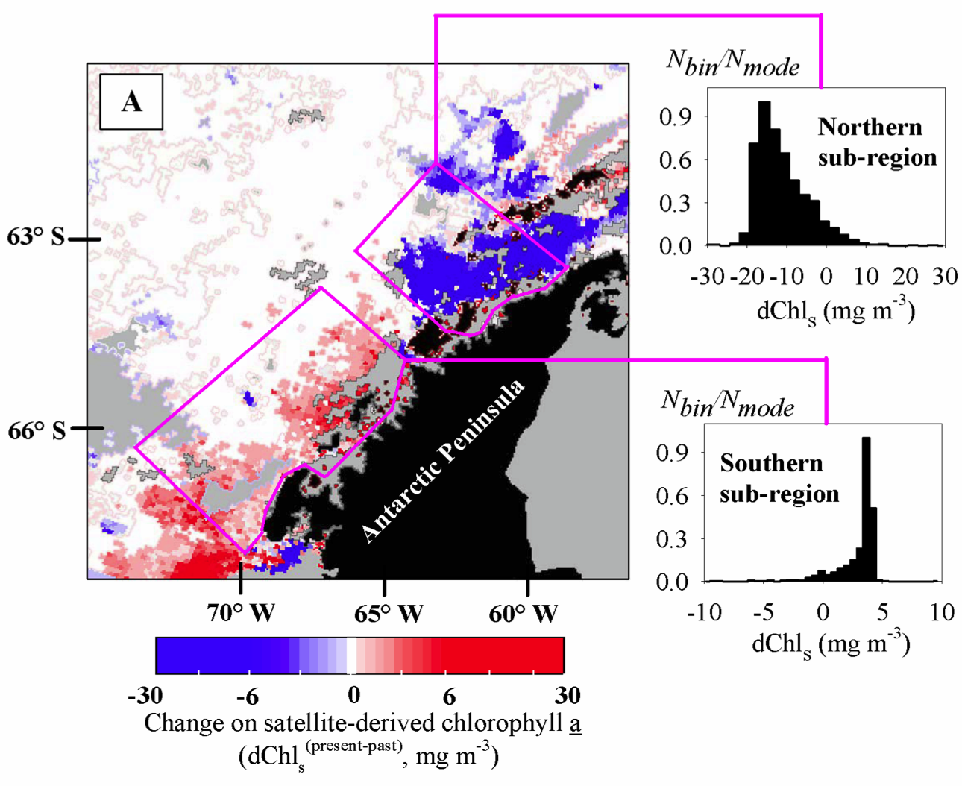
Changes in phytoplankton: (1978-86 to 1998-2006)
CZCS SeaWiFS
-90%
The gap:
area of no change
+67%
Montes-Hugo et al Science 2009

Slide 33
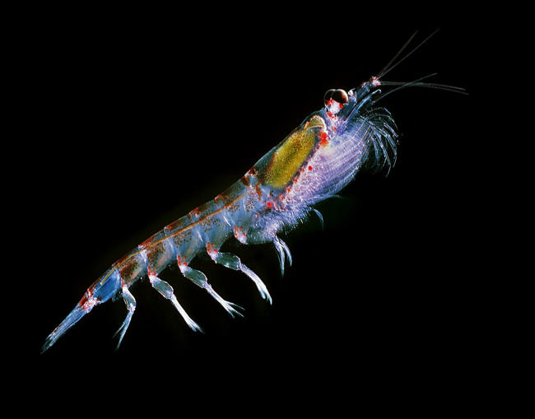
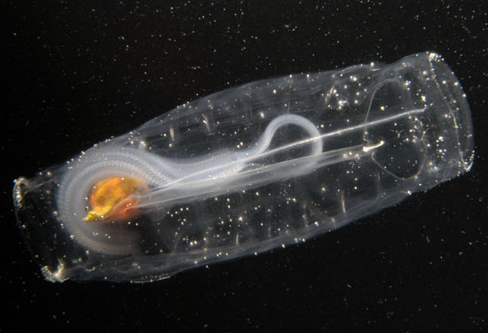
Antarctic macrozooplankton
Antarctic krill Euphausia superba Antarctic larvacean Salpa thompsoni
Photo: Andrew McDonnell Photo: Laurence Madin

Slide 34
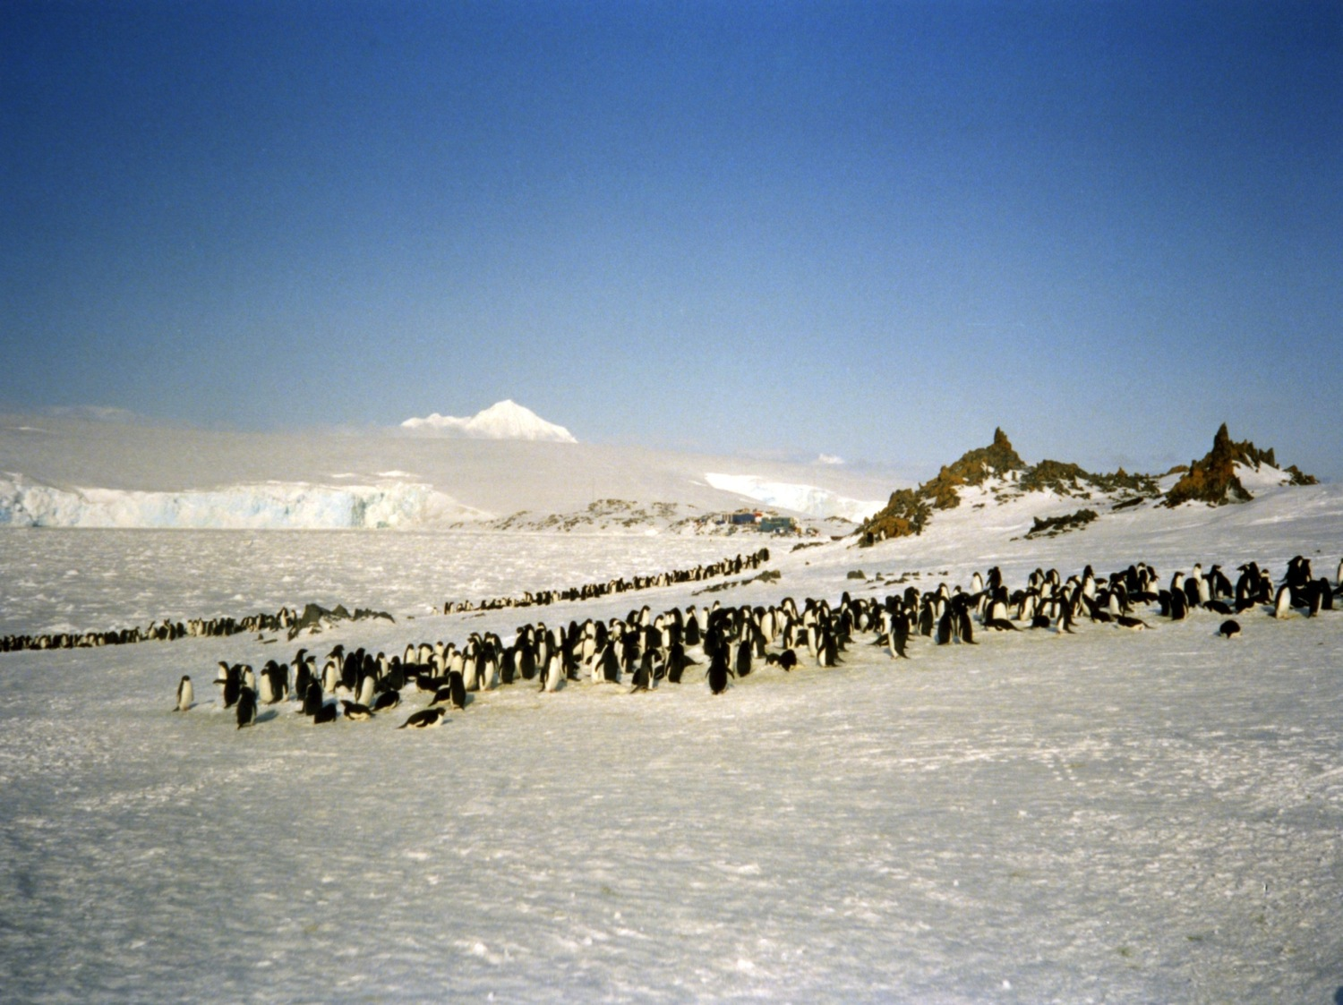
Torgerson Island 1991: 12,000 breeding pairs of Adélie Penguins
Photo by Mark Moline

Slide 35
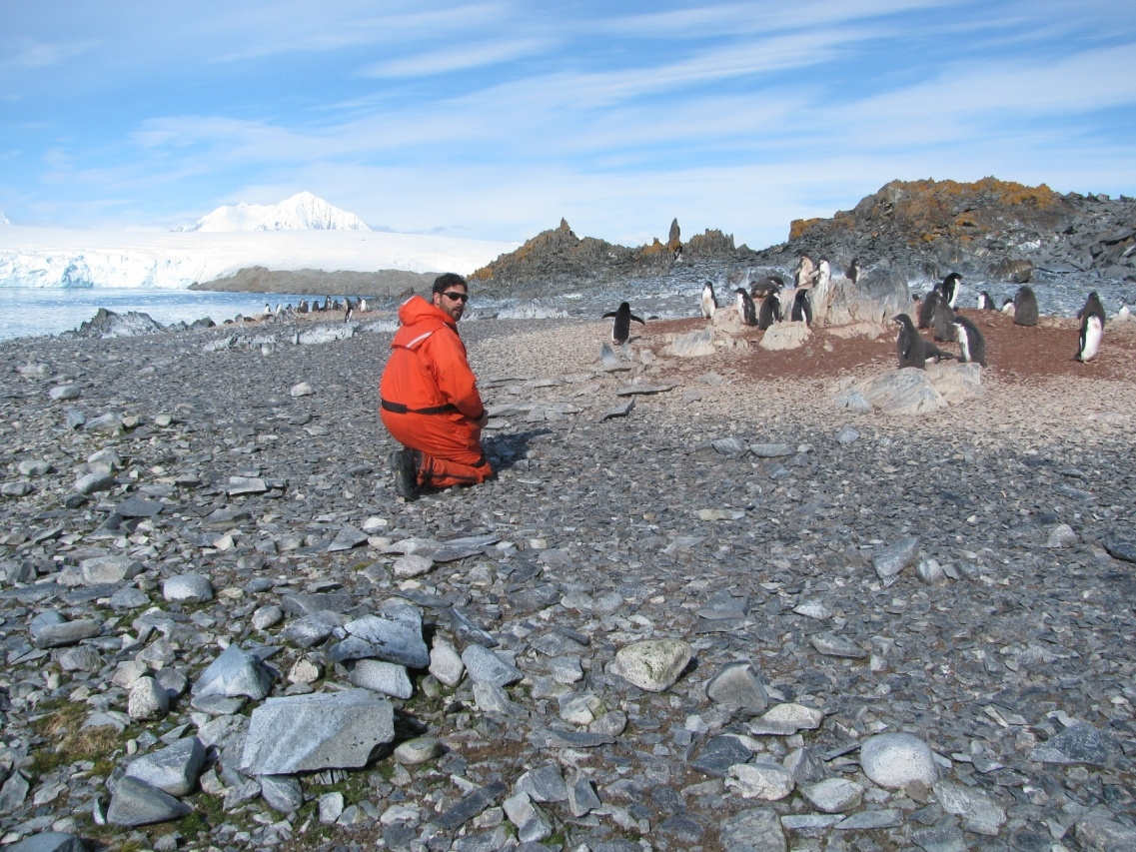
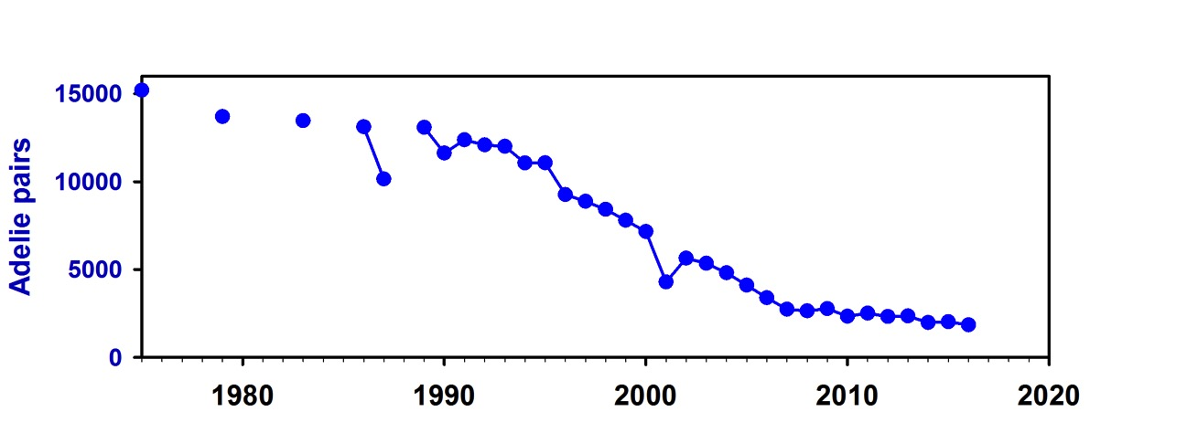
Torgerson Island 2013: <2500 breeding pairs of Adélie Penguins
Photo by Mark Moline

Slide 36
Thesis Statement:
Bacterioplankton metabolize up to 50% of the daily production in marine ecosystems. Bacterial assemblages are highly diverse and dynamic. Yet the basic composition and functional capabilities of these communities are virtually unknown in Antarctic Seas.
I propose to carry out a pilot study of the taxonomic and functional composition of bacterial communities over the continental shelf in the Austral summer.
This information will contribute to a baseline against which to assess future change.

Slide 37
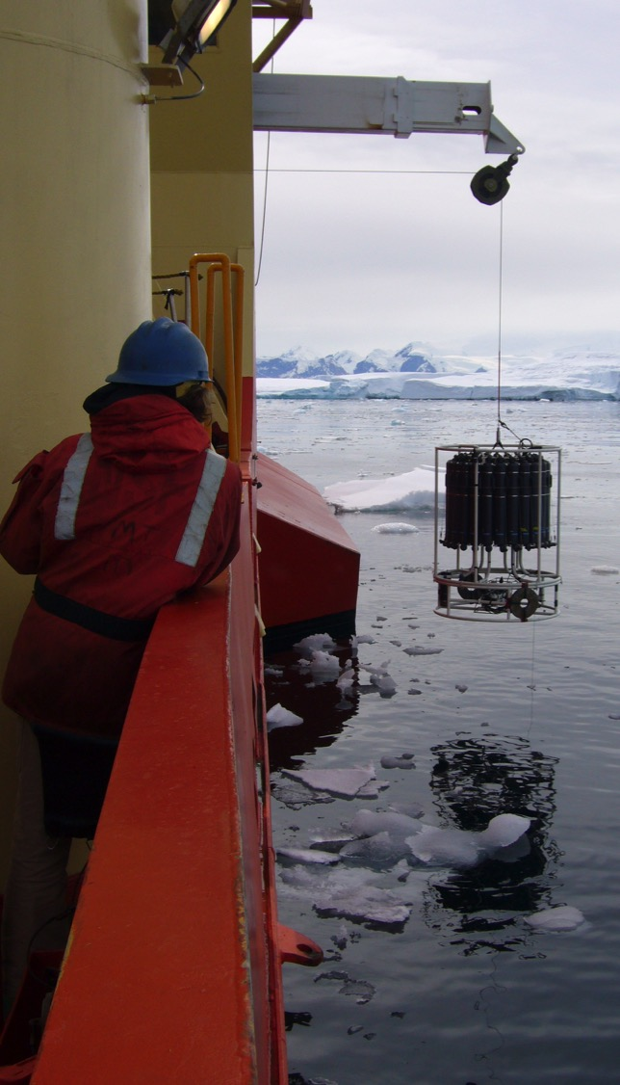
Methods & Materials
Plankton samples will be collected in Niskin bottles on CTD-Rosette casts at 10, 100 and 1000 meters depth at 6 predetermined stations in the Palmer LTER Grid.
Ancillary environmental data (temperature, salinity, chlorophyll, nutrients, bacterial abundance, etc) will be collected by LTER personnel.
Samples will be extracted for DNA and RNA using Qiagen kits and frozen (-80C) for PCR amplification and Illumina sequencing back at Brown.
DNA and RNA sequences will be identified with reference to a Luria Lab database of marine sequences (3% similarity)

Slide 38
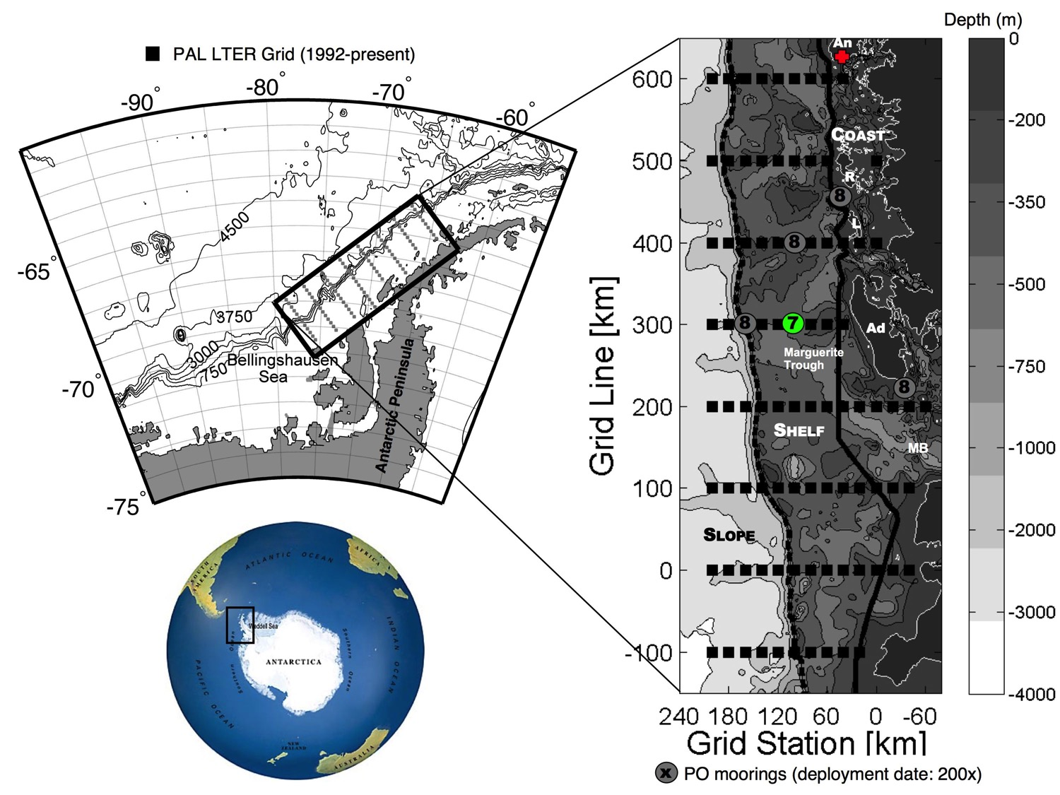
Study Area: January 2018

Slide 39
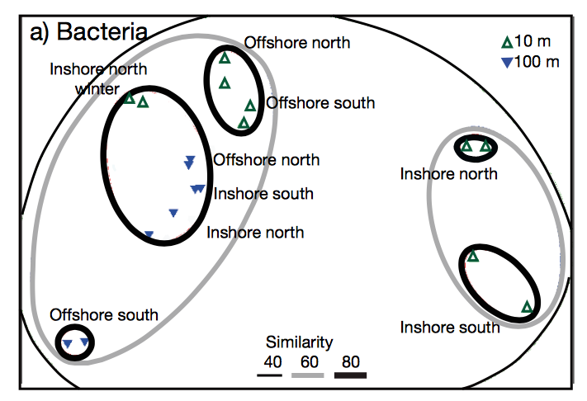
Anticipated Results

Slide 40
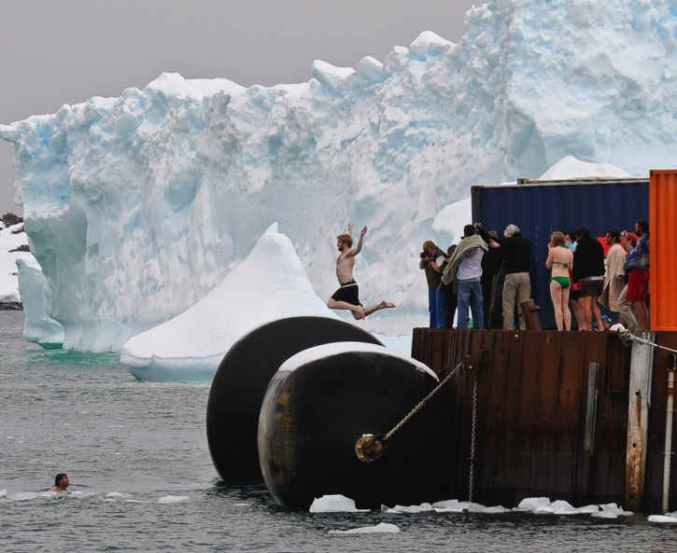
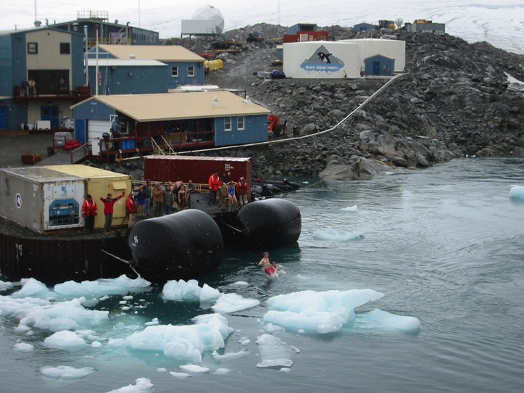
Implications
The results of my study will:
1. provide new high resolution data on the structure of polar bacterioplankton communities and
2. form a baseline form evaluating change in the base of polar foodwebs

Slide 41
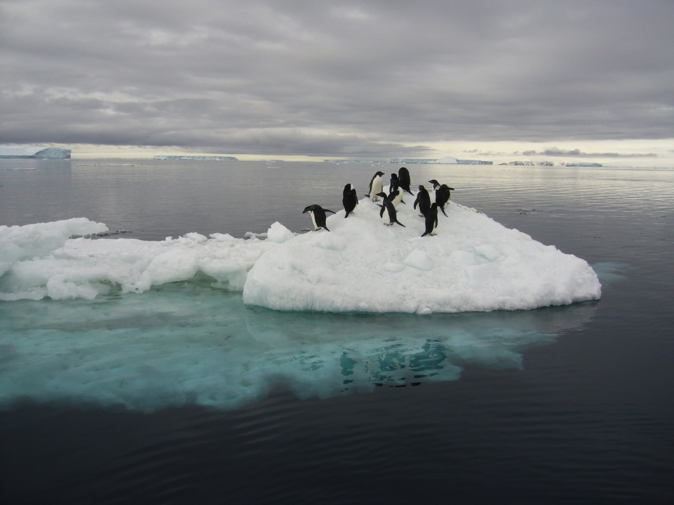
Thanks very much for your attention

Slide 42
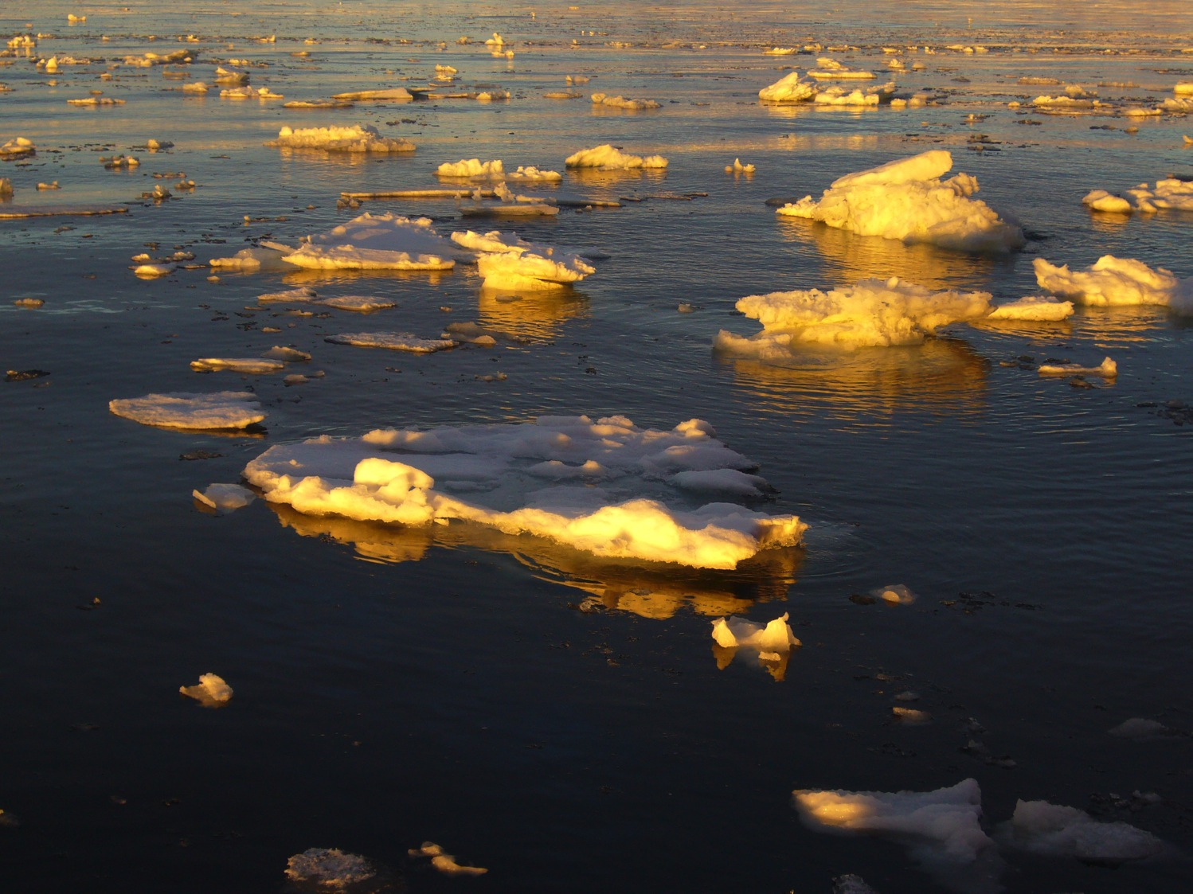
Questions?

Slide 43
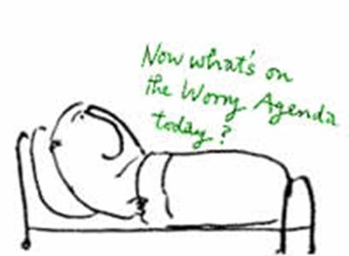
What Can Go Wrong?
Uncertainty about material
Interruptions
Running out of slides
Running out of time
www.rcpsych.ac.uk/.../ anxiety/images/grap6.jpg
http://www.cs.aau.dk/~luca/SLIDES/howtotalk-ru.pdf

Slide 44
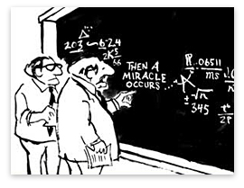
Uncertainty About the Material
Best is if you are sure about the material you present
  Trim the other parts out – if possible
If you have to address something important that you are unsure of …
  Acknowledge the gap in your understanding
    “I’m working on this part” or “I’m looking into it”
  Pose the issue in the future research section at the end
  Or raise it as a question yourself
  From What's so Funny About Science? by Sidney Harris (1977)

Slide 45

Interruptions
During Your Presentation
www.rscni.ac.uk/.../netmanage/networkindex.htm
Don’t look irritated or rushed
Answer – briefly – just enough to straighten it out
  Then carry on with your presentation without checking back
A question that you will answer later in your talk?
  Say “Good point; just wait two slides”
Requires a long answer and is not critical understanding?
  Say “Good point; I’ll come back to it at the end of the talk”
http://www.cs.aau.dk/~luca/SLIDES/howtotalk-ru.pdf

Slide 46
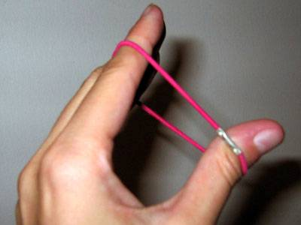
Finishing Too Fast
http://photolog.icyshard.com/archives/26things3/stretch.jpg
Short talks are better than long ones – opens up times for questions
What to do
  Don’t make a personal comment
    “hum, I’m running out of slides …”
  Stretch it a little -- see if you can think of an example, or story, to bolster your points
  Conclude unhurriedly, summarizing your main points, but don’t be repetitious
http://www.cs.aau.dk/~luca/SLIDES/howtotalk-ru.pdf
Notes:
Go to 49 then back to 43

Slide 47
Running Out of Time
“He cannot speak well that cannot hold his tongue”
Thomas Fuller, 1732, Gnomologia
Avoid this – impolite to other speakers and the audience: if it happens
  Do not assume that you can carry on past your time
  Do not skip all of your slides looking for the right one to put on next
  Conclude – on time wherever you are in your talk -- by making your main points
    In Powerpoint you can just type the number of your concluding slide and press Enter to skip right to it
http://www.cs.aau.dk/~luca/SLIDES/howtotalk-ru.pdf
http://www.fw.msu.edu/orgs/gso/documents/GSOWorkshopDocsSp2006/CairnsSpeakingAtLength.pdf

Slide 48

Questions
Questions after your talk help you in writing up your research
  Identifies parts the audience did not understand
  Focuses and adds dimension to your analysis
You can repeat the question – but don’t check back “Did I get it right?”
  This gives you time to think
  The rest of the audience may not have heard the question
  (If you heard the question incorrectly, it presents an opportunity for clarification)
http://www.erp.wisc.edu/profdev/Talkhandout05.doc
http://www.firekills.gov.uk/seniors/cool/howstart/images/howstart.gif

Slide 49

Preparing for Answers
Usually you have thought more about the material than anyone else -- this puts you in a stronger position than you may think
Keep your answers short and to the point -- don’t respond with another lecture
Anticipate typical questions and prepare for them
  Generalizability of your findings to other times? Other places? Other conditions?
  Methodological bias? Uncertainties? Exceptions? Priorities?
Still concerned about questions?
  Make extra slides – perhaps on details of instrumentation or methodology
http://www.regislasvegas.org/images/class-pic-hand-raised.jpg

Slide 50

Difficult Questions
If you really don't know the answer
  Don't feel that you have to invent an answer on the fly -- you are only human and you can't have thought of everything
  Say “That’s a good point, let’s discuss it afterwards”
If the questioner disagrees with you and it looks like there will be an argument then defuse the situation
  "We clearly don't agree on this point, let's go on to other questions and you and I can talk about this later"
http://www.erp.wisc.edu/profdev/Talkhandout05.doc

Slide 51
You are in Good Shape
Senior Thesis Seminar is a good platform to develop and improve your presentation skills and confidence
Available to you: the amazing ‘Barnard Speaking Fellows’
http://speaking.barnard.edu/

Slide 52
Conclusions
Presenting your research is critically important in advancing both your ideas and your reputation
Structure your content in a way that is comfortable for you and understandable by your audience
  Use your own style to your advantage – be authentic
Think ahead about where you might encounter difficulties and figure out ways to overcome it

Slide 53
Share Your Experiences
Things that have worked for you …
Issues that have come up …

Slide 54
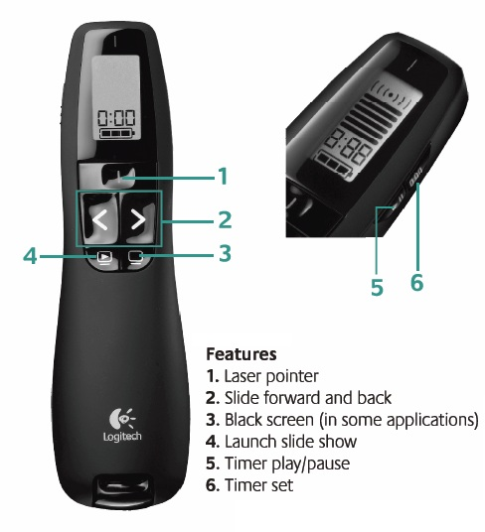
Logistics
Schedule posted on website
Upload files before class on Courseworks (pptx or pdf)
Write your comments during the presentation
Go over summary of comments with advisor
Be there and
ask questions!

