Slide 1
A brief git tutorial
Barnard / Columbia Senior Seminar
Fall 2020

Slide 2
What is version control
A Version control system keeps track of a set of files and saves snapshots.
Using version control allows you to confidently make changes to your code (and any other files), with the ability to roll back to any previous state.
This help avoid filling our directories up with files that look like this:
my_code.py
my_code_version2.py
my_code_version2B-RPA-edit.py
my_code_FINAL_VERSION.py
my_code_THIS_IS_ACTUALLY_THE FINAL VERSION.py

Slide 3
version control vs. git vs. github
Version control is the general concept of tracking progress (controlling) versions of your code
Git is a specific software that allows you to do version control.
Github is a website to host different folders that are version controlled (= repositories)
All of these platforms are independent of your file / code type

Slide 4
Why should you be using git?
To track changes and progress in your code efficiently
To save earlier states of your code (e.g. versions of a code you used for a paper)
To share your code with collaborators either to trouble shoot or for a collaborative coding project (requires github)
To back-up your code (requires github)
To add it to your CV (requires github)
For collaborative projects in which several people work on the same code, version control is a must.
Github = google docs for programming projects

Slide 5
How to use this tutorial
I highly recommend you follow the steps that I’m showing you here on your own computer and pause the video while you’re doing it!
I will be using a Mac operating system in this demo. The process should be very similar on linux but might differ a bit on Windows (for example, you might need to download a terminal app).

Slide 6
Using the terminal
What’s the terminal?
The terminal replaces your mouse in navigating your folder system.
Cheat sheet
ls list the name of files in the current folder
pwd shows the current path, i.e. which folder you’re in
cd folder_name move into the folder named folder_name
cd .. move out of the current folder
open file_name opens file named file_name
You can also use a GUI: git-scm.com/downloads/guis/

Slide 7
Download and install git
https://git-scm.com/
Tell git your name and email:
git config --global user.name "Your Full Name”
git config --global user.email “your_uni@columbia.edu”
Let’s navigate into a folder and start git
git init - this initiates a git repository in the current folder
You only have to do this once

Slide 8
Using git – tracking versions
git status – shows you the files that are tracked
git add file_name – adds the file to be tracked.
git commit –m ‘commit message’– commit to store the first version of your code.
Work on your file. Whenever you are at a new point where you want to save your current state (version) add and commit.

Slide 9
Using git – checking differences
git log – shows you all your commits
git diff – shows you any current changes
git diff commit#1 commit#2 – shows you changes between commits
git checkout commit#1 file_name – reverts your file back to what it was at commit#1 stage

Slide 10
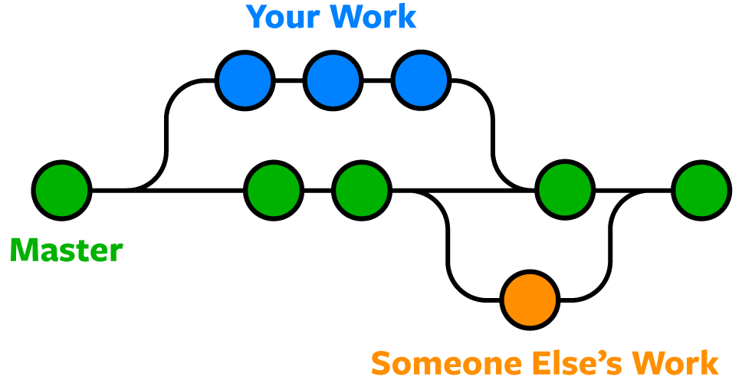
Using git – branching
git branch branch_name commit#1 – creates a branch based on commit#1 with name branch_name
git branch branch_name – creates a branch based on current master with name branch_name
git branch - shows you all branches that exist

Slide 11
Using git – branching
git checkout branch_name – switch over to the branch called branch_name to work in that
make any changes, commits, tests, can do git diff
Option (1) Discard branch
git branch -d branch_name – removes that branch

Slide 12
Using git – branching
Option (2) Merge branch into master
git checkout master – takes you back to the master branch
git merge branch_name – merges any changes you did into the master branch

Slide 13
Push your repository to github
Need to make an account https://github.com/
Setup a new repository on the website
git remote add origin git@github.com:jaustermann/SeniorSeminar.git - this permanently links the repository on your computer with github (only sync’s when you ask it to)
git push origin branch_name
Github:
Look at code
Look at older commits
Send links to collaborator
Track contributions (insights)

Slide 14
Additional resources
https://try.github.io/
http://swcarpentry.github.io/git-novice/
As soon as you know the jargon - google

