Slide 1
Figures and Tables
Senior Thesis Seminar – First Semester Students

Slide 2
Where you will use graphics?
Presentation
Proposal
Poster
Thesis

Slide 3
Why do you need graphics?
Clarify thinking
  It is useful to create diagrams and figures early in the process of developing your ideas.
  Having a figure outline can be the first step towards writing your thesis
Communicate your study effectively
  A picture is worth a thousand words (will reduce your text and make it easier for others to follow).
Notes:
A well chosen and well labeled figure can reduce text length, and improve proposal clarity.
If you don’t understand the process, you can’t draw it. Second, good drawings are very valuable. Other scientists will understand your paper better if you can make a drawing of your ideas.

Slide 4
What can graphics show?
Present structure of your study/experiment
  Logic flow of whole or parts of your argument
  Illustrate key concepts
Explain particular methods
  Scientific equipment that you are using and an explanation of how it works
  Flow chart showing the steps in a process and the possible causes and consequences
Notes:
Proposals often contain figures from other articles. These can be appropriate, but you should consider modifying them if the modifications will improve your point.

Slide 5
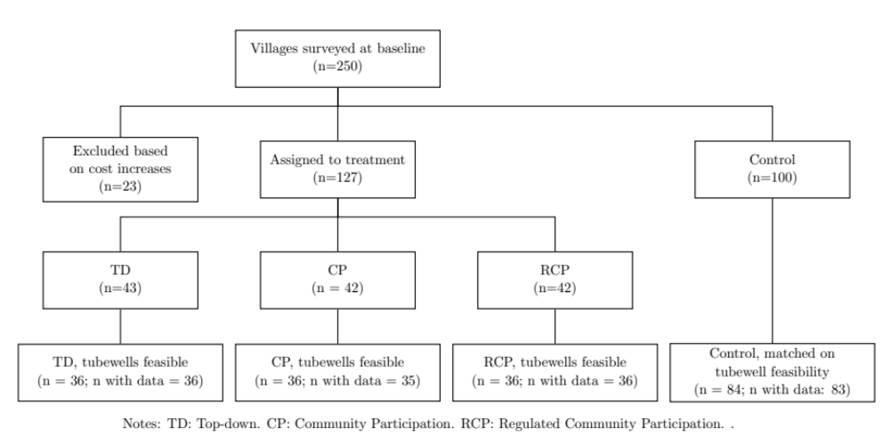
Diagrams
Figure 3: Experimental design and sample
Illustrate the structure of the study

Slide 6
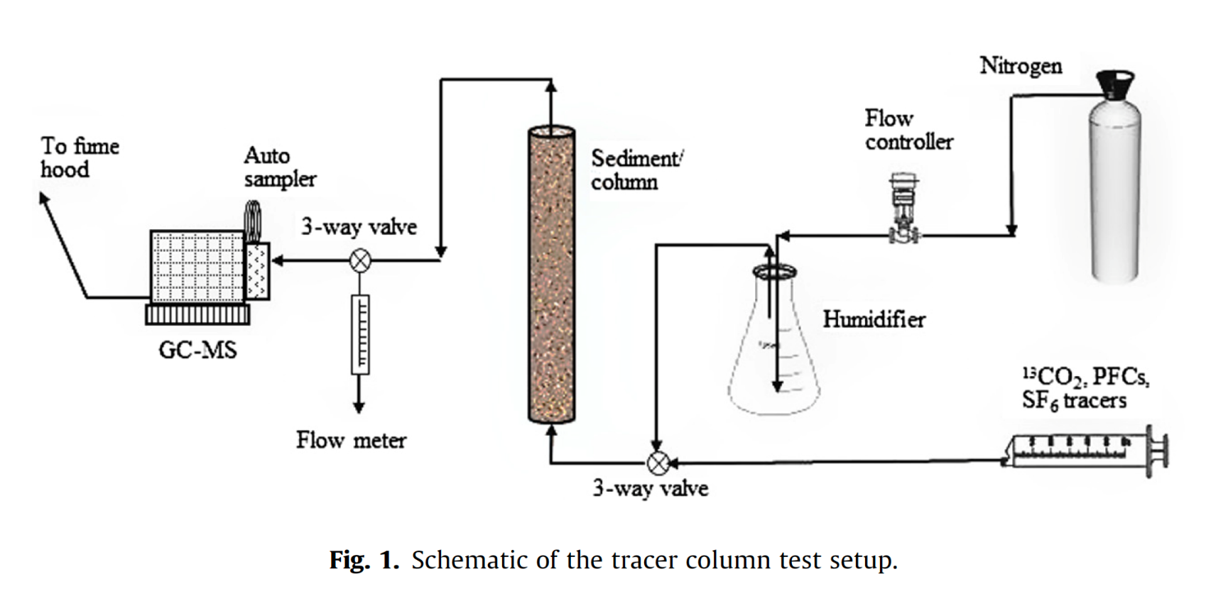
Diagrams
Illustrate methods

Slide 7
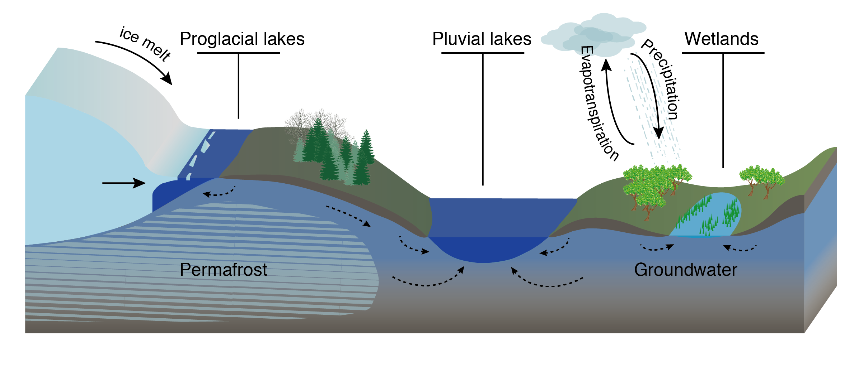
Diagrams
Illustrate concepts

Slide 8
What can graphics show?
Communicate results
  Preliminary results
  Anticipate results – show potential relationships
  Results from related project – explain potential differences
Notes:
Proposals often contain figures from other articles. These can be appropriate, but you should consider modifying them if the modifications will improve your point.

Slide 10
What can graphics show?
Communicate results
  Preliminary results
  Anticipate results – show potential relationships
  Results from related project – explain potential differences
Summarize main results from related literature
Proposals often contain figures from other articles. These can be appropriate, but consider modifying them if the modifications will improve your point.
Notes:
Proposals often contain figures from other articles. These can be appropriate, but you should consider modifying them if the modifications will improve your point.

Slide 11
How to “screen grab” a figure from a paper
High resolution figures are often accessible in the online version of the paper
  https://advances.sciencemag.org/content/6/9/eaay2935?intcmp=trendmd-adv
You can open the relevant PDF page with a vector graphic software to modify your figure (e.g. Adobe Illustrator, Affinity Designer)
If you need to screenshot a figure, do it at maximum zoom
When saving your ppt you can compress figures to make your file size smaller

Slide 12
Where and how to place figures and tables?
Incorporate figures and tables in the text following the first citation.
  The number of species from 1990 to 2000 has increased (Fig. 1).
Mention and explain the figure or table in the text before it appears.
Number figures in the order in which they are cited in the text.
Same with tables.
Each table and figure needs a caption
  At the top for tables, at the bottom for figures
  Can highlight the key findings but should not include full description
  Explain lines, points, etc.
  Include references, data sources
  Figure 1: Comparison between the location of earthquakes obtained using a traditional approach versus the new relocation approach used here. Black line denotes the plate boundary.

Slide 13
How create graphics? Guiding questions
Does it convey key relationship in data or key element of study?
Is it self-explanatory and guide reader to “take-home message”?
Is it clear and simple?
  No extraneous legends or lines.
  No bells and whistles like 3D unless this serves an important purpose.
  High resolution.
Are axes labeled and units indicated?
Is all critical information there?
  Show uncertainty with error bars
  Indicate goodness of fit
Does figure distort data in any way?
Does it use space well?
Do the colors work?
Is the font big enough?
Figures need revisions – just like text.
Notes:
Font: different for presentation vs. thesis

Slide 14
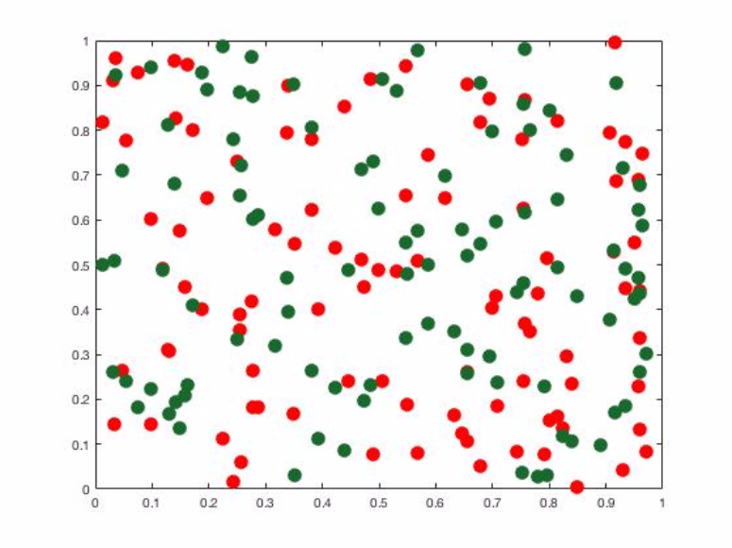
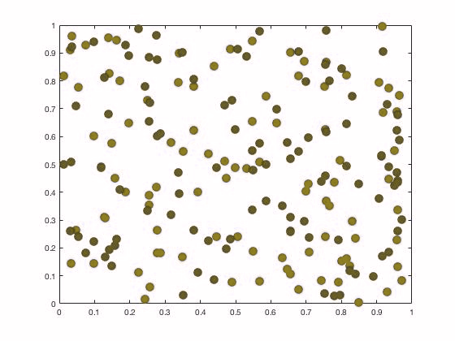
Choice of color
Use high contrasts that are still useful if printed in black and white
How do the colors look to someone who is color blind?
Normal
Color Blind

Slide 15
Tools to make good figures
Excel (don’t use the default!)
Computational environments: Matlab, python (Matplotlib), R, …
Cartoons, diagrams: Affinity Designer, Adobe Illustrator, PowerPoint, …
Maps: GMT, GeoMapApp, ArcGIS, QGIS…
You can use drafting programs (Affinity Designer, Adobe Illustrator, …) to modify your figures

Slide 16
Additional resources
Senior Seminar website
How to …
Create Good Graphs and Captions
Almost Everything You Wanted to Know About Making Tables and Figures
Ten Simple Rules for Better Figures

