Slide 1
Concept Mapping
for
Senior Seminar
Updated Spring 2025

Slide 2
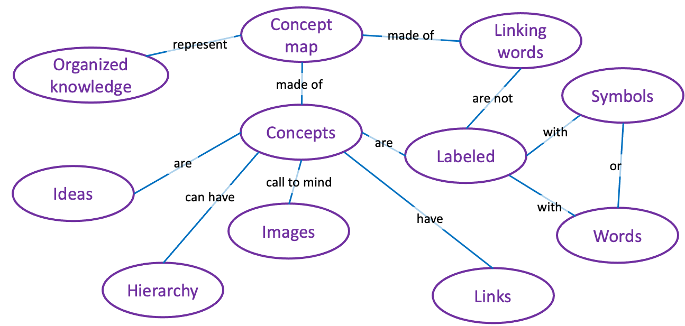
What is a concept map?
/
/
Modified from Megan Sumeracki
https://www.learningscientists.org/blog/2020/11/19-1

Slide 3
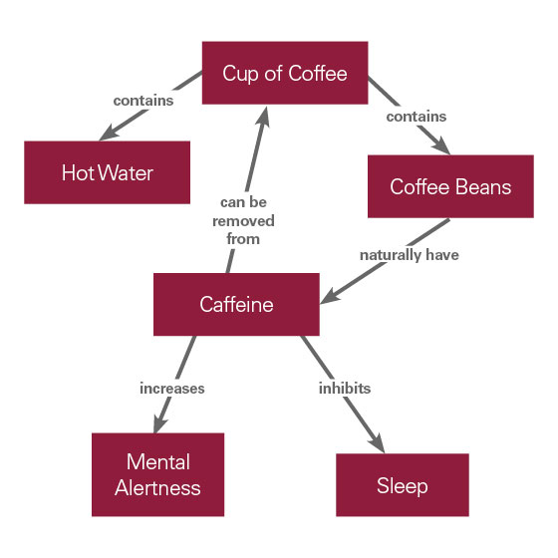
What is a concept map?
Basic: a diagram of relationships between ideas/concepts/components of a system
https://medicine.llu.edu/academics/resources/concept-mapping-medical-school

Slide 4
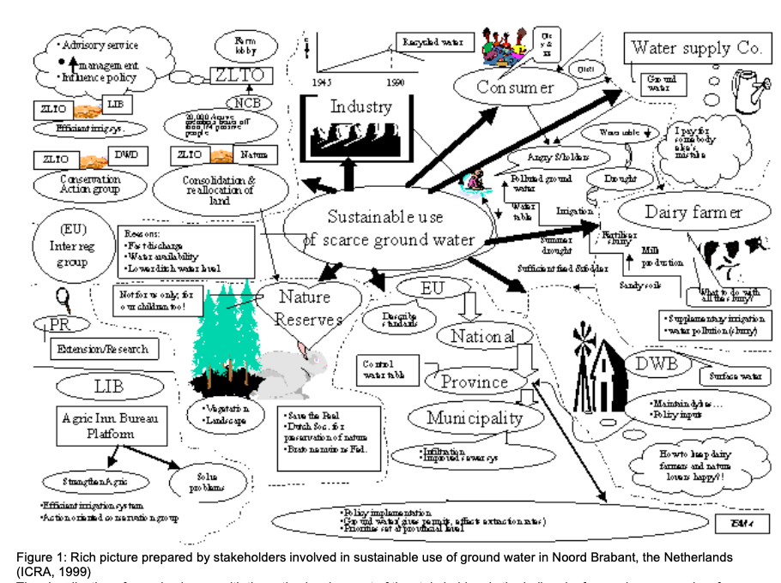
What is a concept map?
Basic: a diagram of relationships between ideas/concepts/components of a system
Beyond: schematics, flowcharts, diagrams, infographics, illustrations, rich pictures, mathematical equations, 3D models, stakeholder engagement
Rich picture prepared by stakeholders involved in sustainable use of ground water in Noord Brabant, the Netherlands (ICRA, 1999)

Slide 5
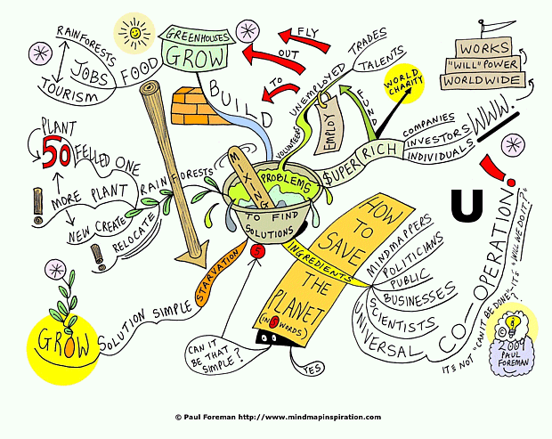
Why use concept maps?
Brainstorm
Organize ideas
Identify gaps in knowledge or assumptions
Designing study design or paper narrative
Visually illustrate complex systems or where your research fits in a larger system
Collaboration

Slide 6
Introduction: Representing a study system
Concept Mapping for the Senior Thesis
Mehmel 2017

Slide 7
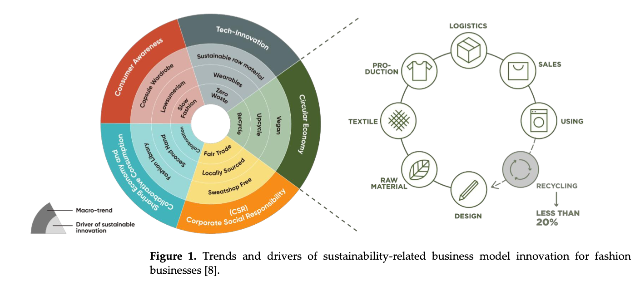
Introduction: Representing a study system
Wu et al. 2022

Slide 8
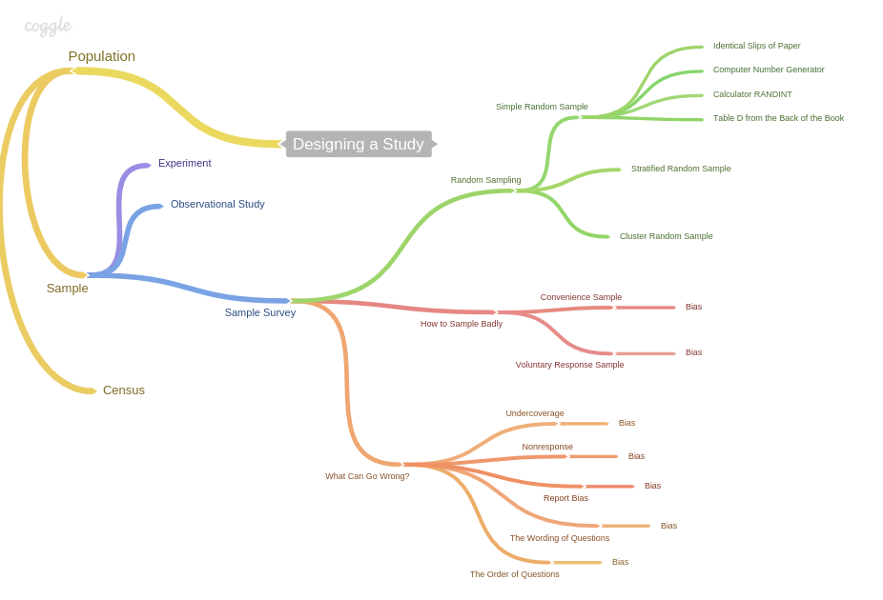
Methods: Designing or representing study
http://keaysclass.blogspot.com/2014/10/coggle-it-ap-stat-designing-study-41.html

Slide 9
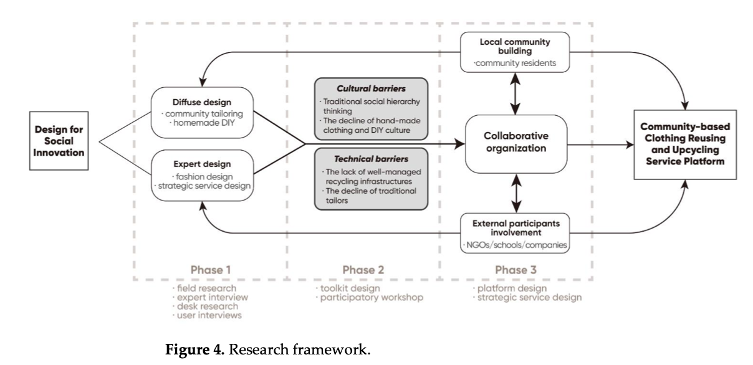
Methods: Designing or representing study
Wu et al. 2022

Slide 10
Methods: Designing or representing study
Macey et al. 2024

Slide 11
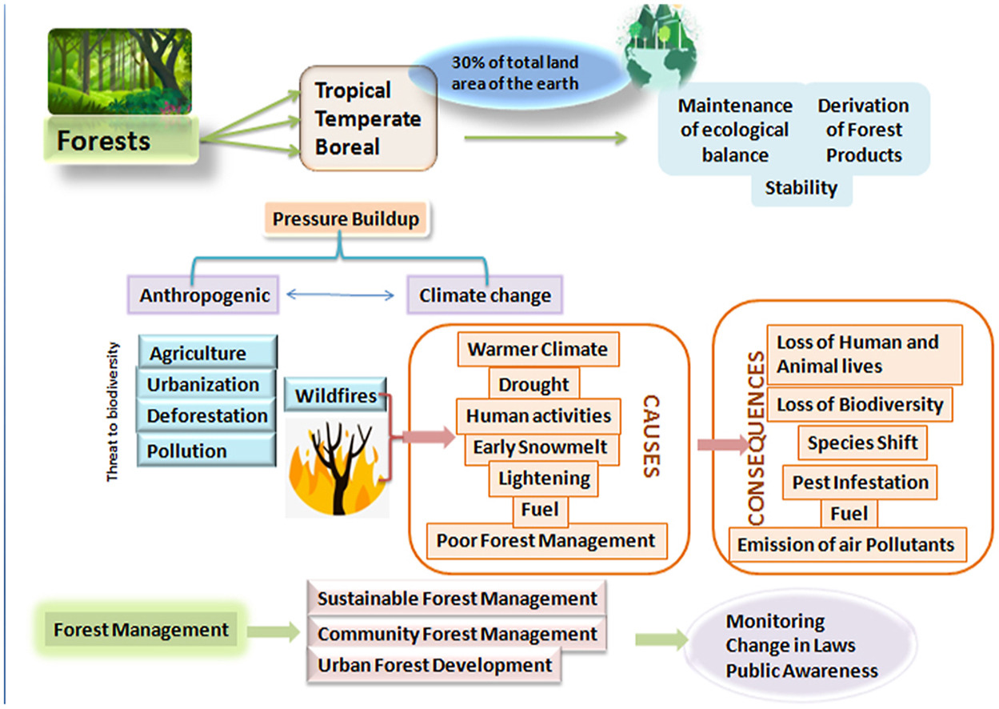
Graphical Abstract: Summary of study topic
Mansoor et al. 2022

Slide 12
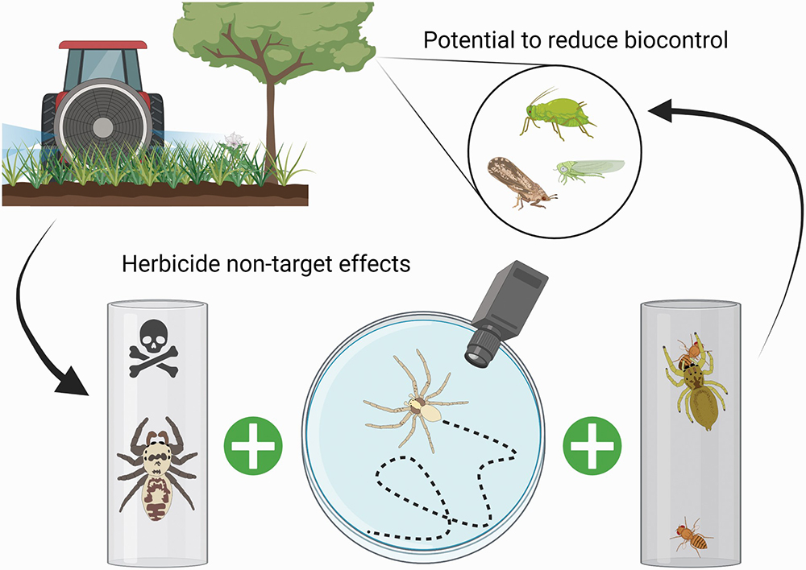
Graphical Abstract: Key finding of study
Schmidt-Jeffris et al. 2021

Slide 13
Concept Mapping for the Senior Thesis
Why are we spending time on concept mapping today?
Learn more about your project structure by making explicit mental connections and association patterns
Share your concept map provides practice for presenting complex material to others (e.g., a general audience)
Modify your map to reflect evolving problem solving in the future

Slide 14
Making a Concept Map
List the key concepts with relevant terms/need to know details
    Who, what, where, why, when, how, how much
    Processes
    Drivers
    Relationships – cause and effect, etc.
    Characteristics
Group closely related concepts
Connect the concepts by drawing lines with verbs or short phrases to describe the relationship
Don’t just make a map. Make connections and ideas.
Check Yourself: Does this map make sense?
Free concept mapping tools: https://en.wikipedia.org/wiki/List_of_concept-_and_mind-mapping_software

Slide 15
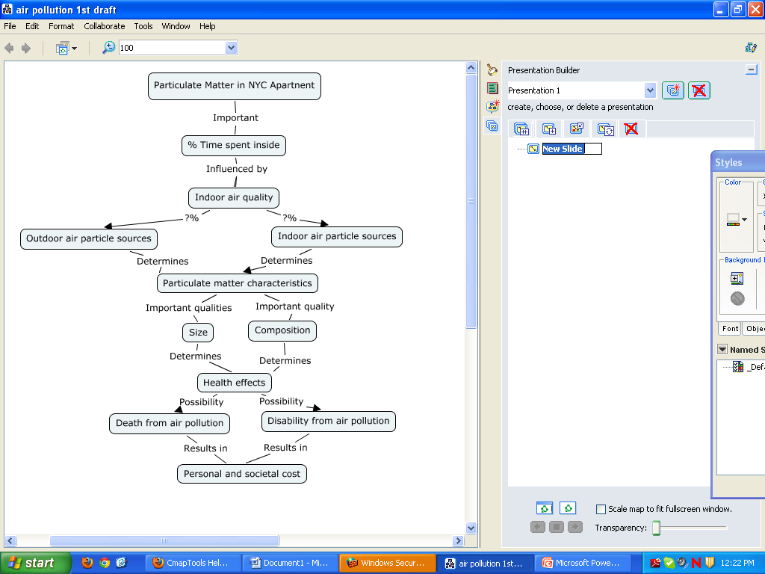
Generated from Example Outline on Senior Seminar website
https://cool.barnard.edu/envsci/wp-content/uploads/2024/09/Outline_example_1.pdf

Slide 16
Making a Concept Map
Climate Change
Notes:
(if time and space/classroom set up and number of students allows)… write climate change on the board and encourage students to not talk for 5 minutes and take turns adding components or concepts and relationships to this system on the board. Reiterate this is not meant to assess understanding of climate change in anyway, but rather a warmup activity to prepare for your own mapping. After 5 minutes, describe of solicit how the resulting map could be refined (categories, reorganization, colors, thickness of lines showing relative relationship, standardization, examples added, gaps identified, etc.).

Slide 17
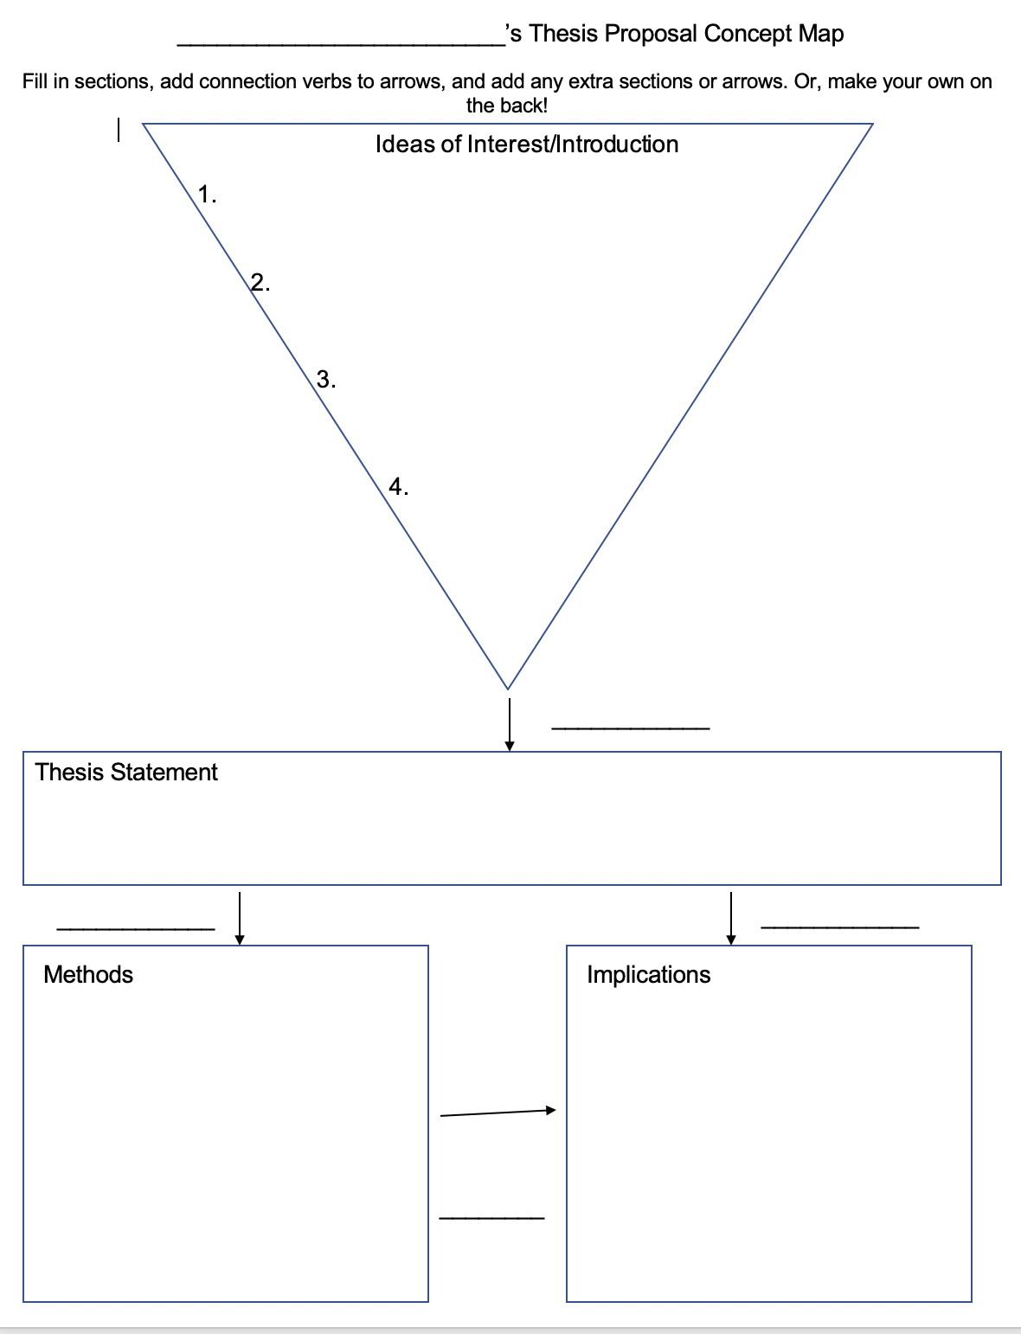
Need a jumpstart?

Slide 18
What next? Make your Map!
On your own, map
  the main concept of your study,
  the background information in your Introduction,
  or the design of your study (Methods)
In small group discussions
  Describe your concept map
  Why did you create the map in the way that you did?
  Why those concepts? Why those connections?
  What information do you wish you had?
Consider showing your map to your mentor or advisor and refining together – could end up as figure in your proposal!

