Slide 1
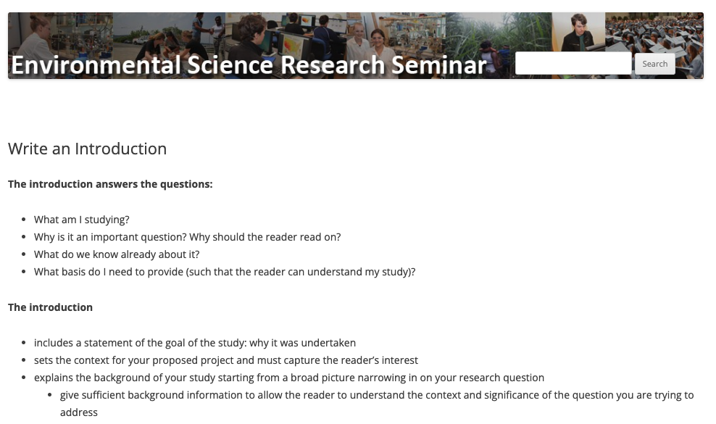
Writing your thesis proposal introduction
Use this page and the
resources at the bottom

Slide 2
Introduction: The Function
Thoroughly sets up the scientific story of your project by answering these questions:
What am I studying?
Why is it an important topic? Why should the reader continue?
What do we know already about this topic?
What is unknown about your topic (the challenge or problem)?
How will your research help address the problem?
  What do you propose to do?
What do I need to tell the reader so they will be able to understand (and contextualize) the rest of the thesis?

Slide 3
Introduction: The Flow (triangle/funnel method)
Goal of triangle: tell a story while moving from very general to specifics about your topic
1. Big picture of topic (include “hook” to grab readers)
2. Literature review on background & previous research
(what is known on topic)
3. Define problem / knowledge gap
(what are unknowns)
4. How your thesis will help fill knowledge gap
5. Your thesis statement

Slide 4
Introduction: The Flow (triangle/funnel method)
Goal of triangle: tell a story while moving from very general to specifics about your topic
1. Big picture of topic (include “hook” to grab readers)
2. Literature review on background & previous research
(what is known on topic)
3. Define problem / knowledge gap
(what are unknowns)
4. How your thesis will help fill knowledge gap
Key Reminders
Define the problem and background succinctly but comprehensively
Generate curiosity
Remind the reader how your thesis addresses the problem
Include key references
5. Your thesis statement

Slide 5
1. I am interested in studying:
2. I am solving for this problem/investigating this unknown:
3. This topic & problem/investigation is relevant because:
4. My methods of analysis/investigation will include:
5. The implications of this project will be:

Slide 6
1. I am interested in studying: urban heat islands and the social/ecological impacts of Million Trees in cities
2. I am solving for this problem/investigating this unknown: neighborhood/community differences in benefits (heat mitigation) received from NYC trees?
3. This topic & problem/investigation is relevant because: climate justice and how ecosystem services may benefit some communities more than others
4. My methods of analysis/investigation will include: using NYC census tracts for my study area, using iTree to estimate ecosystem services, correlating socio-economics and trees in neighborhoods
5. The implications of this project will be: improving knowledge on urban heat mitigation, building a city guide where trees planting needed/failed

Slide 7
Introduction: General Tips
  Start with thesis statement and work from that
  The question/problem is more important than the system
  Include sufficient detail for a reader with a general-science background (e.g., your peers) to understand the context and significance
  Could end first paragraph with a brief overview
  Cite those who had the idea first AND the most recent and relevant work
  Subheadings are your friends!

Slide 8
Introduction: Some Useful Resources
Course website:
  How to… “write a thesis proposal”
  How to… “write an introduction”
  How to… “do an evidence synthesis”
  Resources > Videos > Google Scholar Tips
Google Drive:
  Example Docs > Thesis Proposals
Course Advisor
Research Mentor
Peers

